Slide 1
Drone Application
Drone Pilot
Presentation by:- Hayedrone Flying Academy

Slide 2
DRONE APPLICATIONS:- Drones have a major user application all over the world. Listed below are a few but not limited to their application. With no limits to imagination a drone can be used anywhere a human cannot be reached.
Presentation by:- Vikas

Slide 3
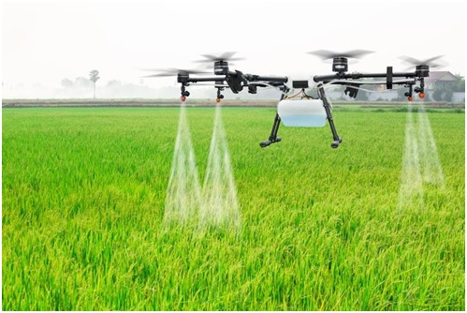
Agriculture
A drone can be used to find the crop type,
plant count, as area index, soil type and even
the soil moisture. You can growth stage, plant
height, nitrogen deficiencies if any, plant
health, detasseling and of course yield
monitoring. Many research scientists use
drones to study minerals and soil with the help
of drones. Sophisticated sensors once fitted on
a manned aircraft can now be fitted on a
simple drone and resolve many problems.

Slide 4
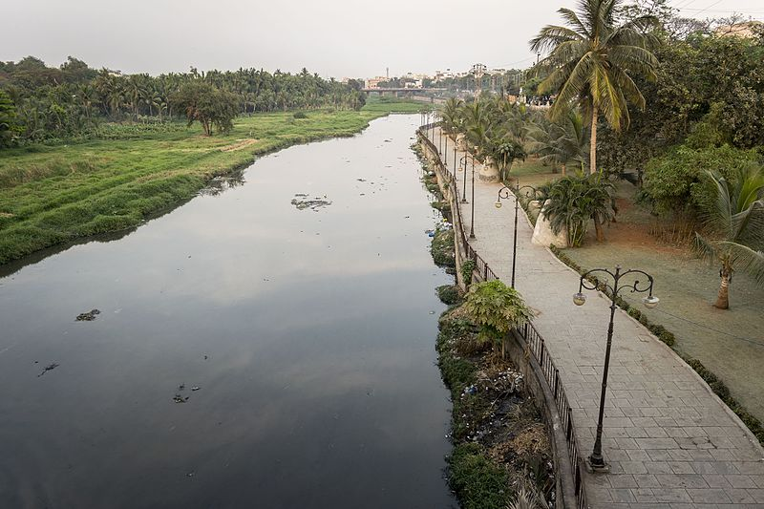
Water
Drones can be used to create irrigated land mapping, impervious surface mapping and watershed planning. Most of the landslides along the river and the flow of the river can be easily monitored from time to time using drones. This indeed reduces risk of flooding.

Slide 5
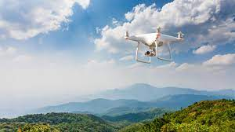
Environment & Climate
Land cover mapping and Carbon capping have become a new interest for the meteorological departments all over the world who are also keen on weather atmospheric studies. Clean tech has more interests in the renewable energy using solar power. We have solar drones that are being positioned in the lowest layers of atmosphere to act as long enduring temporary satellites.

Slide 6
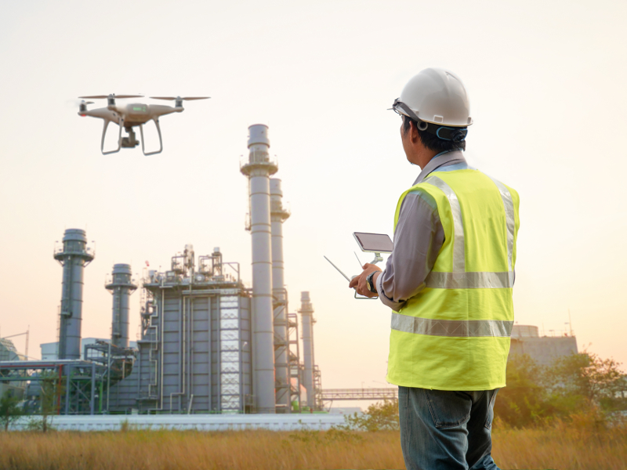
Oil & Gas
Many Oil companies in the Middle East as well as Far East have starting oil spill tracking in the international waters surrounding their countries. Pipeline monitoring is a major business opportunity for drone makers. Environmental assessment as mentioned earlier is also picking up in most of the countries. Pit surveys can be carried out and even mines can be detected saving so many lives.

Slide 7
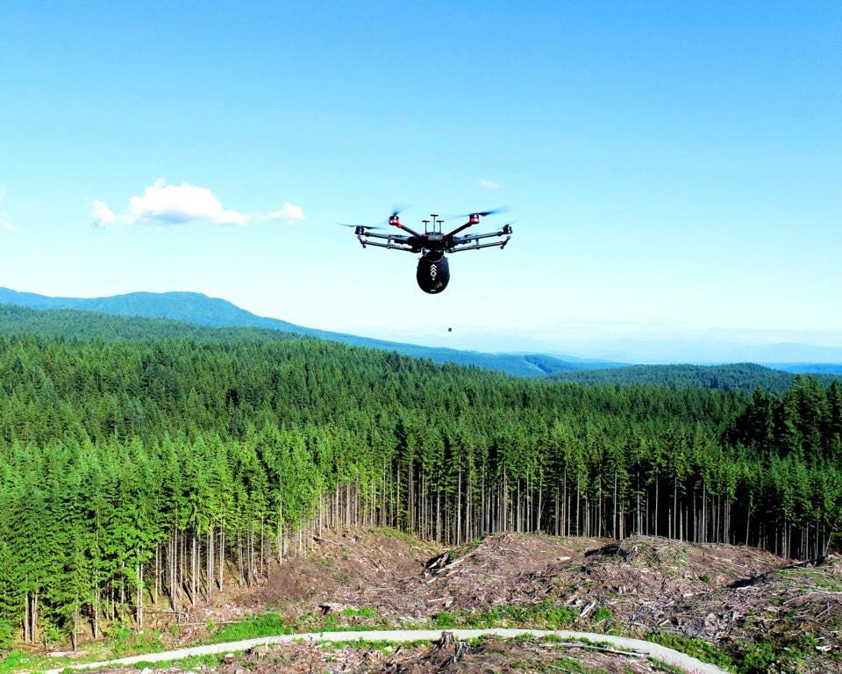
Forestry
Drones have major use in monitoring the biomass in forests as well as keep a track of the Forest health. Disease detection can be done using drones. In India animal monitoring is another important area view extinction of many animals.

Slide 8
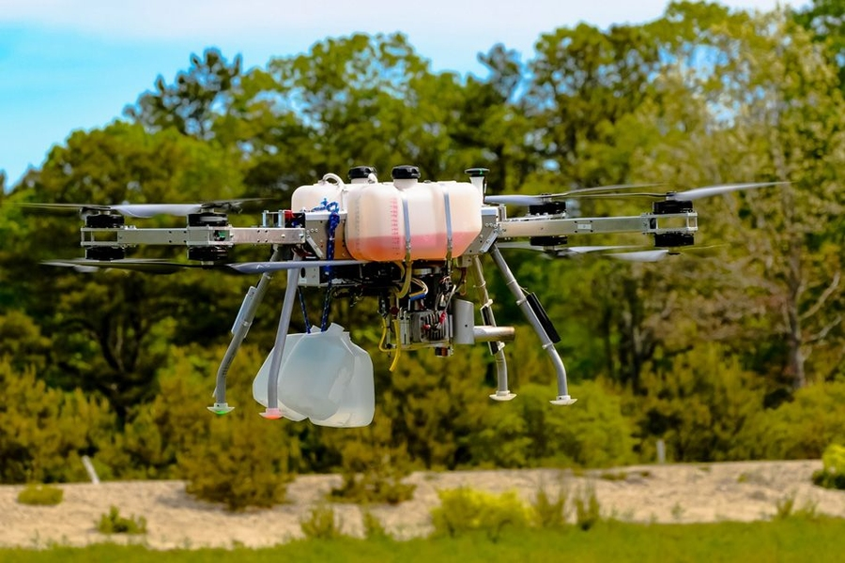
Utilities:-
Drones can be helpful for vegetation management as well as asset verification. It can't pay bills though; we need to monitor those ourselves.

Slide 9
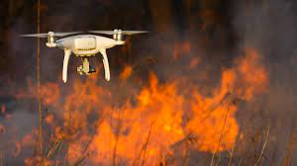
Disaster Response
India seems to be showing more interest towards
wildfire monitoring lately as concerns for forests
has grown high. Flooding is a very important area
as it becomes critical to asses situation during
floods and hence using drones to understand the
geographical situation will help reduce risks.
Damage assessment can be done during natural
calamities with a rapid response provided quickly
by drones in just minutes.

Slide 10
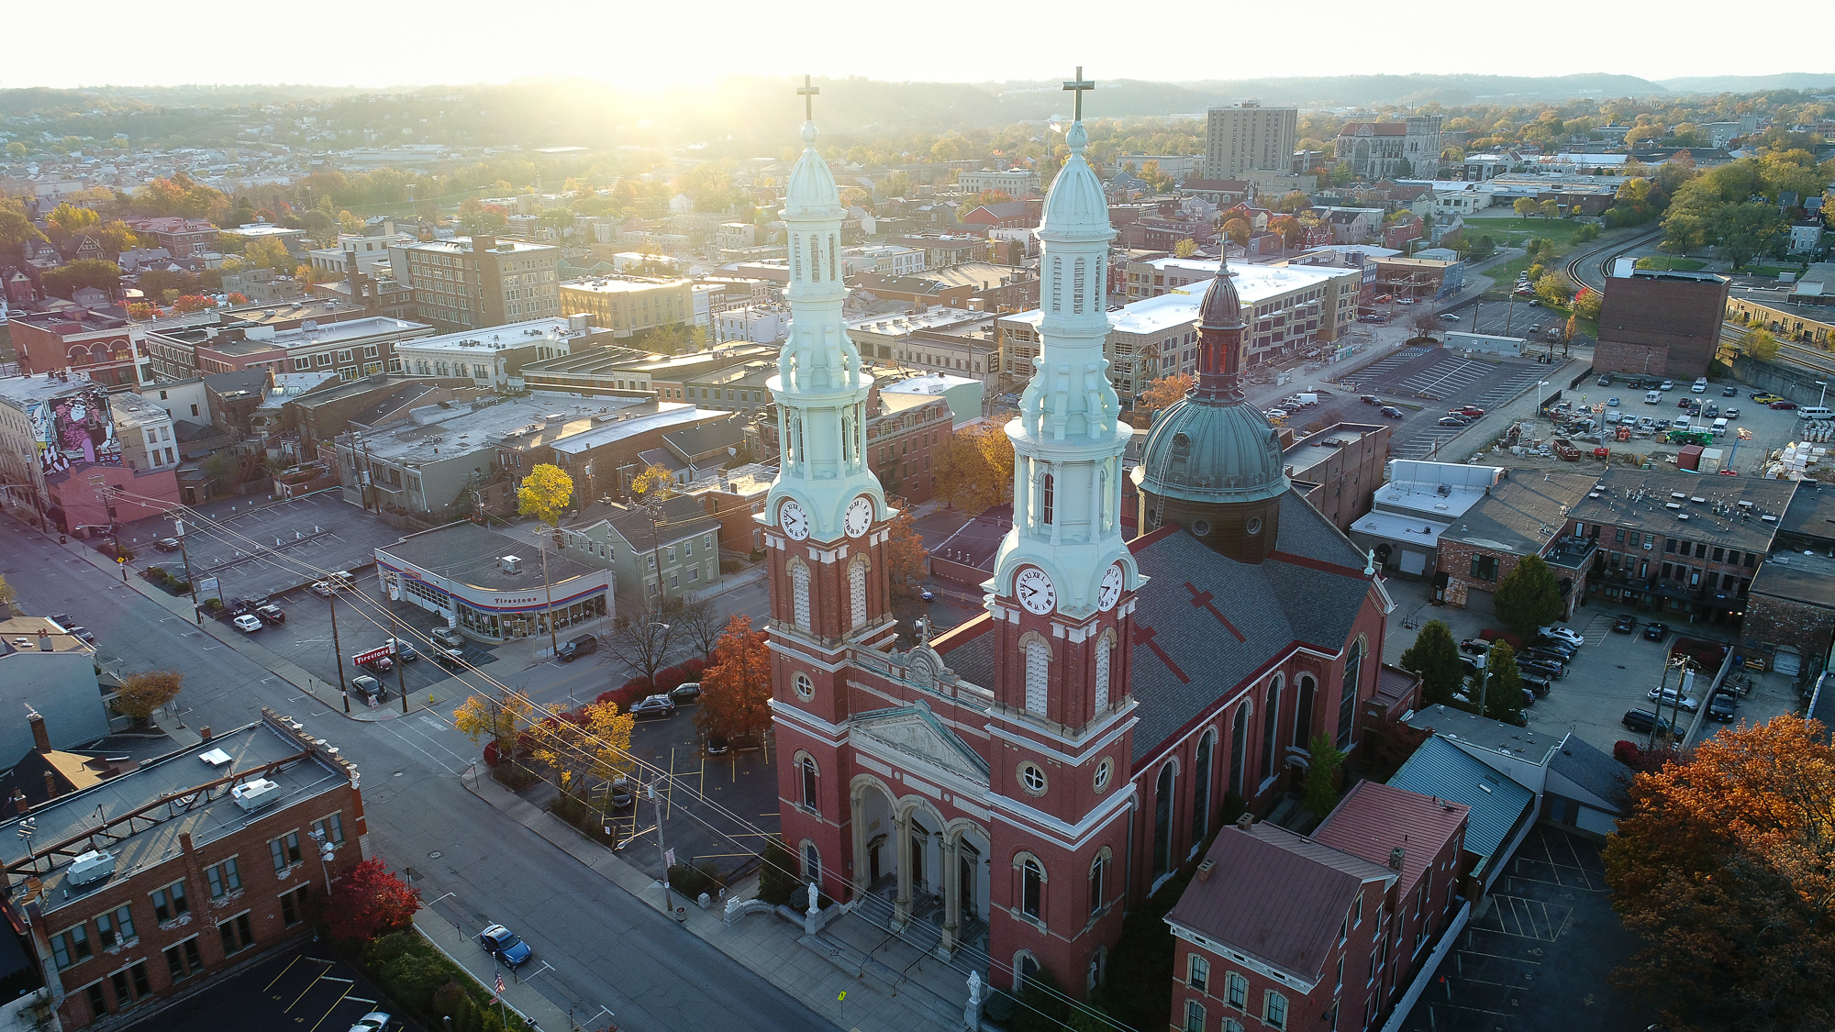
Video & Photography
From news coverage to film making and traffic monitoring to disaster management, getting an aerial footage is an ultimate experience using drones. It was impossible until recently to take extremely difficult shots for film makers. Recent release of FAA regulations exclusively for film makers has helped many production companies to create some eye catching movies. India is also expected to see a major increase in revenues as the regulatory bodies in India start permitting the use of drones for film making.

Slide 11
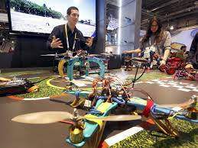
Education
The field of aeronautics is taking a new shape in all the universities in the world with increased student interest towards this amazing field of unmanned systems technology. Drones benefit hugely industrial engineering, robotics studies, 3D printing and much more.

Slide 12
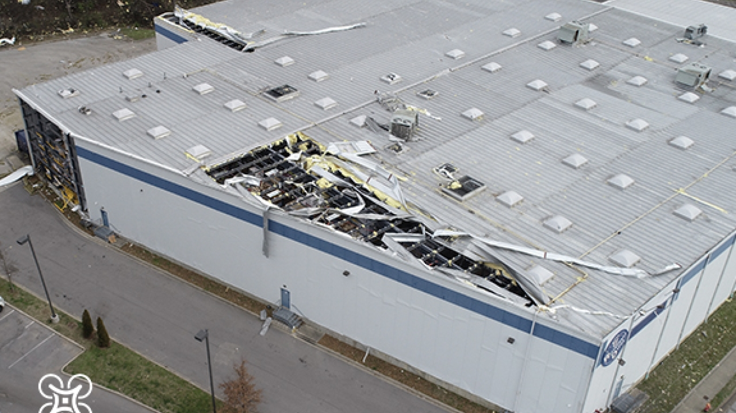
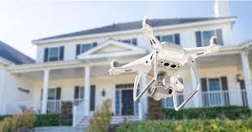
Insurance
Similar to any vehicle insurance, the drone insurance industry is going to take off so well that the early start-up companies in this field will be the best benefactors. We have few UAV insurance companies already in the US and UK including Australia. Indian insurance companies should fast embrace this massive business opportunity.

Slide 13
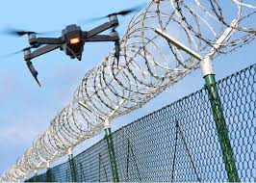
Security
Another major area of concern is security.
Homeland security as well as border
security are a major concern for countries
like India and Israel who are bordered with
many enemies. Also infiltration can be
monitored using drones.
Illegal entry at the borders can be
observed along the line of borders. Indian
agencies are seeking a lot of options for
perimeter securities and this can be
resolved only when DGCA allows
independent organizations to use drones
for their perimeter security.

Slide 14
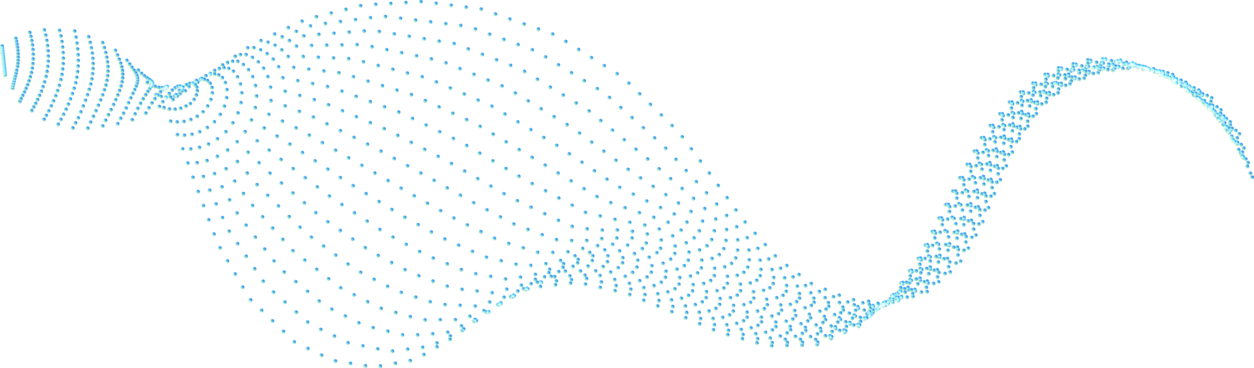
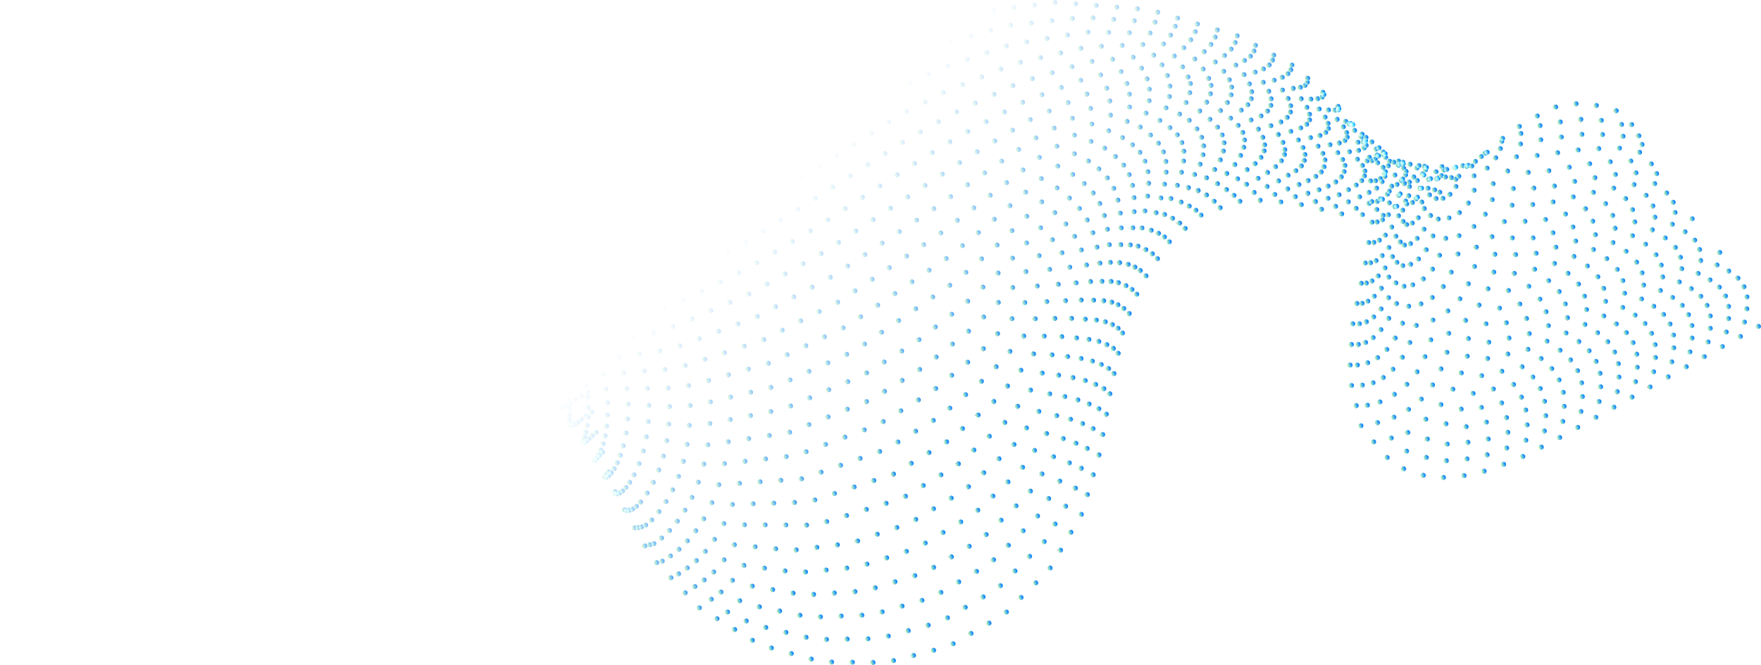


Thanks!
Do you have any questions?
9319678360
CREDITS:- This presentation template was created, Including all data by Hayedrone Flying Academy

